Slide 1
Essential Introduction to Computers
IT Skills
(ITD6106)

Slide 2
Objectives
Define the term computer and discuss the four basic computer operations: input, processing, output, and storage
Define data and information
Explain the principal components of the computer and their use
Describe the use of hard disks, USB flash drives, floppy disks, and other storage media
Discuss computer software and explain the difference between system software and application software

Slide 3
Objectives
Identify several types of personal computer application software
Discuss computer communications channels and equipment and the Internet and World Wide Web
Define e-commerce
Explain how to purchase a personal computer

Slide 4
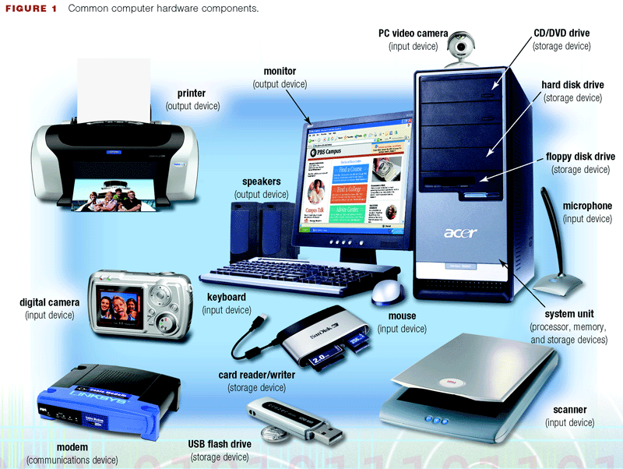
What Is a Computer?
A computer is an electronic device, operating under the control of instructions stored in its own memory, that can accept data (input), process the data according to specified rules (process), produce results (output), and store the results (storage) for future use
Information Processing Cycle

Slide 5
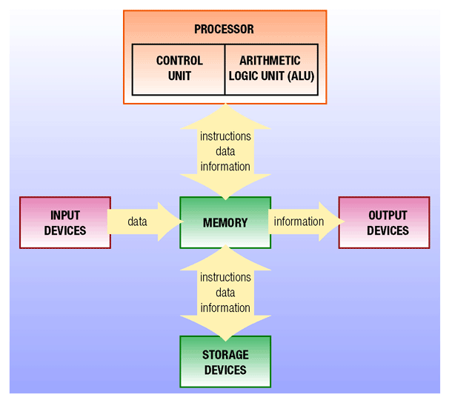
What Are the Components of a Computer?

Slide 6
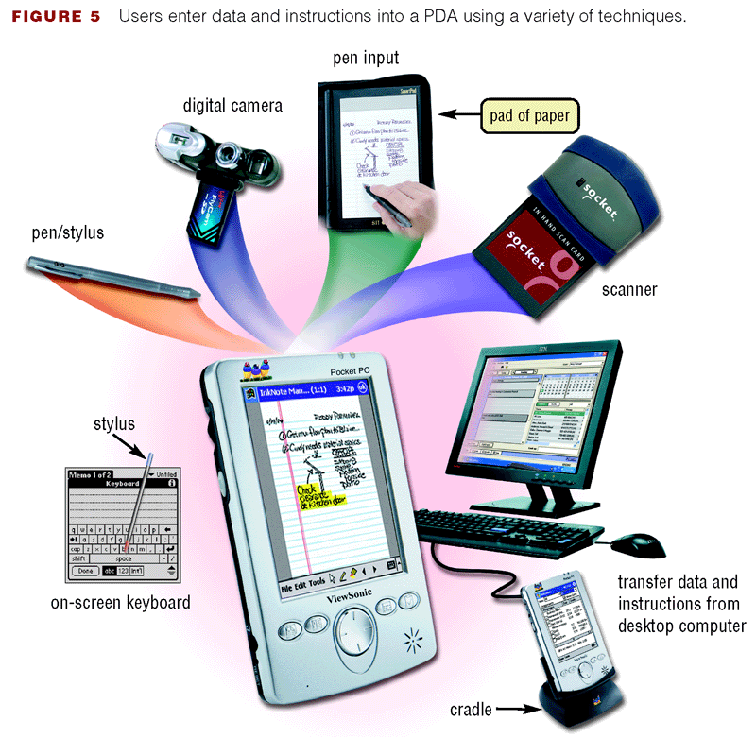
Input Devices
Any hardware component that allows you to enter data, programs, commands, and user responses into a computer
Input Device
Examples
  Keyboard
  Mouse

Slide 7
System Unit
The motherboard, or system board, is the main circuit board of the system unit
The processor, also called the central processing unit (CPU), interprets and carries out the basic instructions that operate a computer
The control unit interprets the instructions
The arithmetic/logic unit performs the logical and arithmetic processes
Memory, also called random access memory, or RAM, consists of electronic components that store data, instructions, and information, as needed by the processor

Slide 8
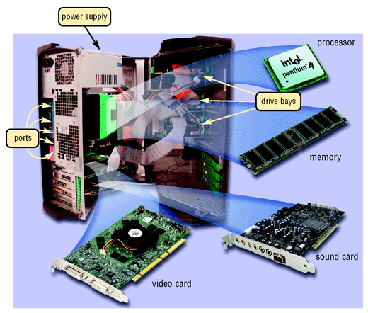
System Unit

Slide 9
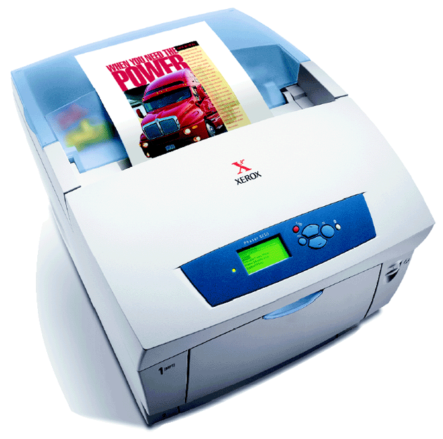
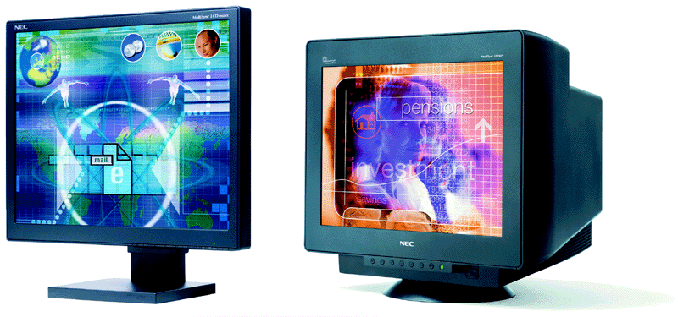
Output Devices
Output devices make the information resulting from processing available for use
Output Device Examples
  Printers
    Impact
    Nonimpact
    Photo
  Display Devices
    CRT
    LCD

Slide 10
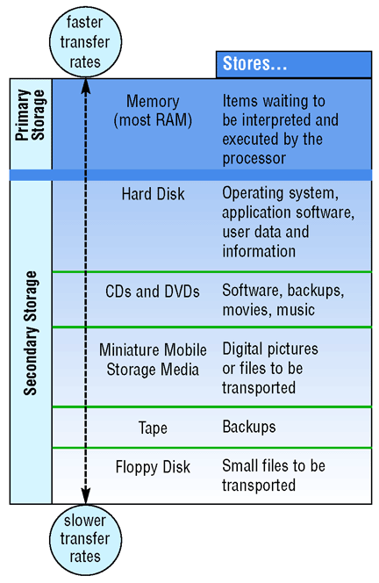
Storage Devices
Used to store instructions, data, and information when they are not being used in memory

Slide 11
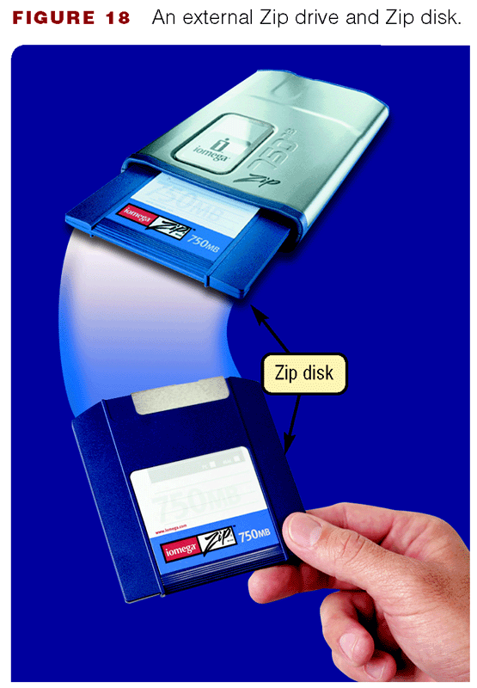
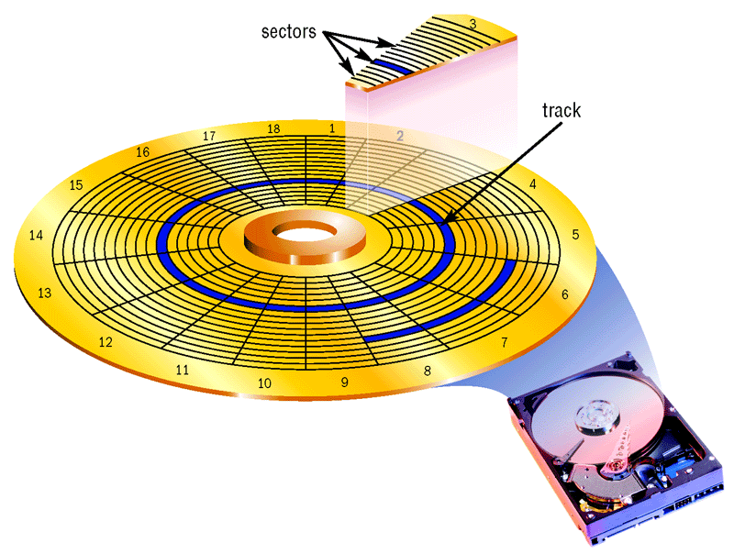
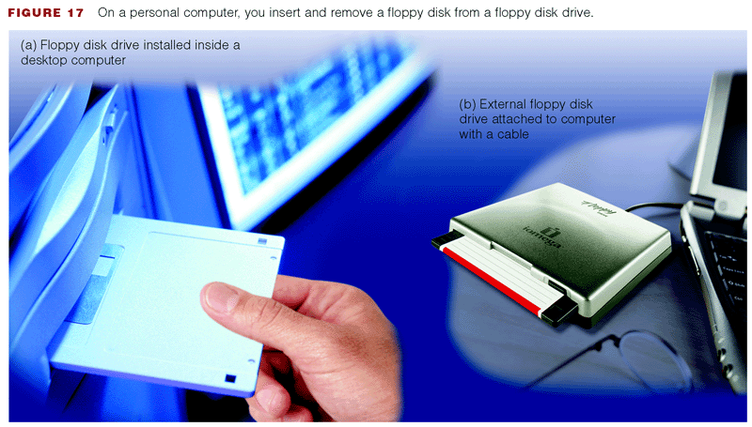
Storage Devices
Magnetic disks use magnetic particles to store items on a disk’s surface
  Floppy disks
  Zip disks
  Hard disks

Slide 12
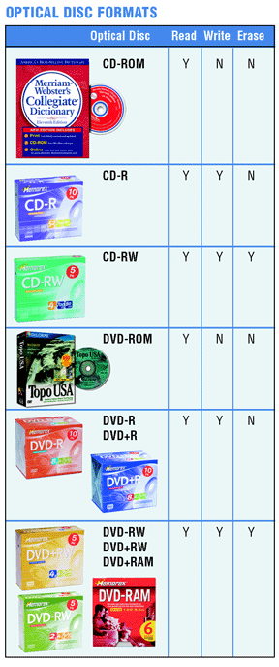
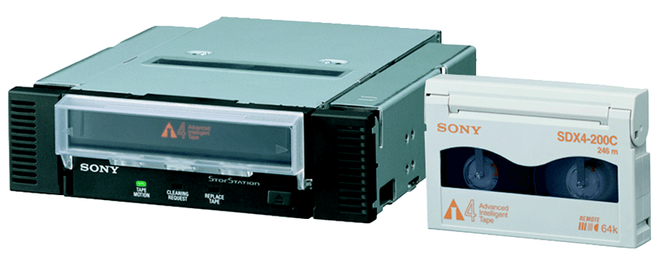
Storage Devices
Optical discs
  CD-ROM
  CD-R
  CD-RW
  DVD-ROM
  DVD-R
  DVD+R
  DVD-RW
  DVD+RW
  DVD+RAM
Tape

Slide 13
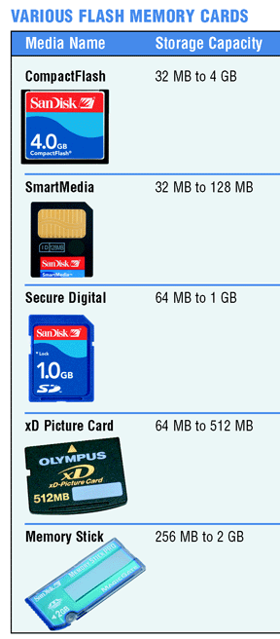
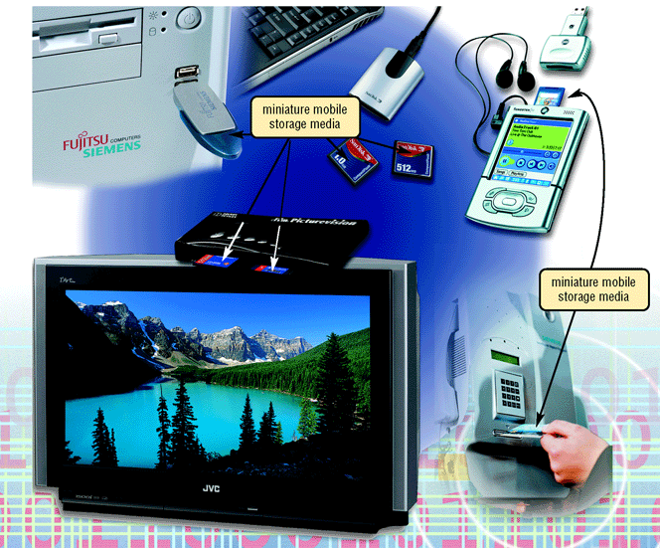
Storage Devices
Miniature mobile storage
media

Slide 14
Communications Devices
A communications device is a hardware component that enables a computer to send (transmit) and receive data, instructions, and information to and from one or more computers
Communications occur over transmission media, such as telephone lines, cables, cellular radio networks, and satellites

Slide 15
Computer Software
System software consists of programs to control the operations of computer equipment
Instructions in the operating system tell the computer how to perform the functions of loading, storing, and executing an application program and how to transfer data
When a computer is turned on, the operating system is loaded into the computer’s memory from auxiliary storage, a process called booting
Most computers use an operating system that has a graphical user interface (GUI)

Slide 16
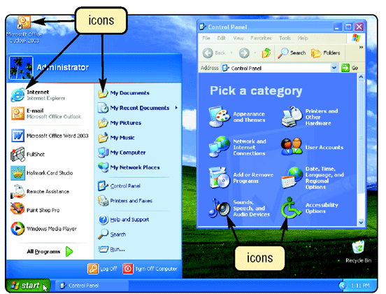
Computer Software

Slide 17
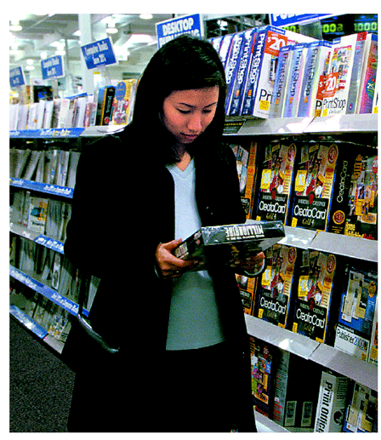
Computer Software
Application software consists of programs that tell a computer how to produce information
  Word processing software
  Spreadsheet software
  Database software
  Presentation Graphics software

Slide 18
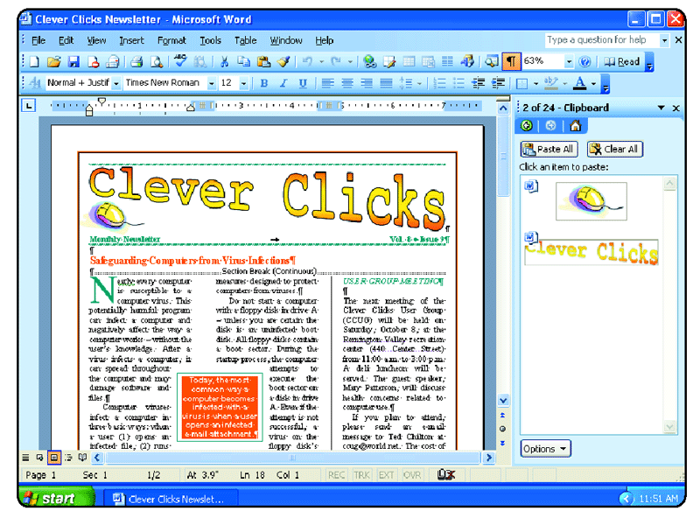
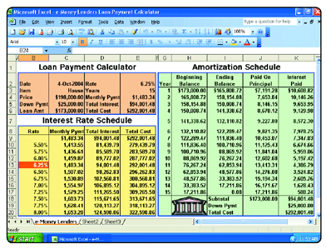
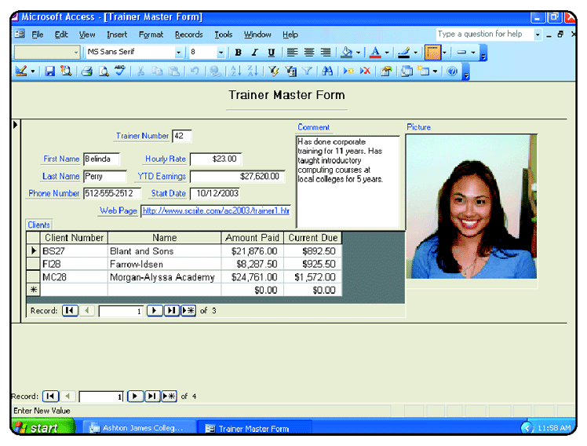
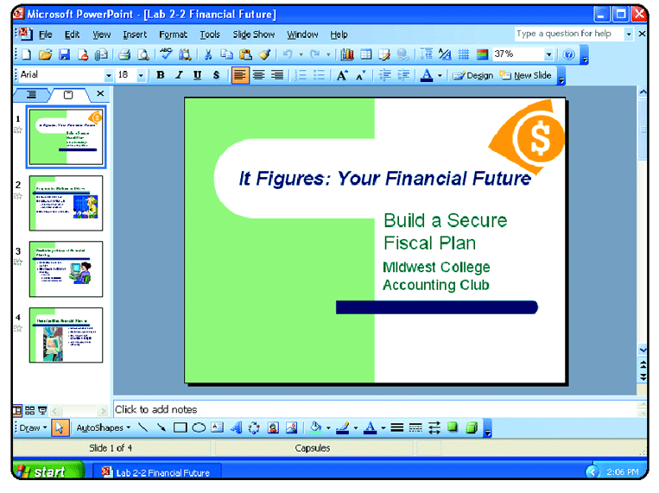
Computer Software

Slide 19
Networks and the Internet
A network is a collection of computers and devices connected via communications media and devices
A local area network (LAN) connects computers in a limited geographic area
A wide area network (WAN) covers a large geographical area

Slide 20
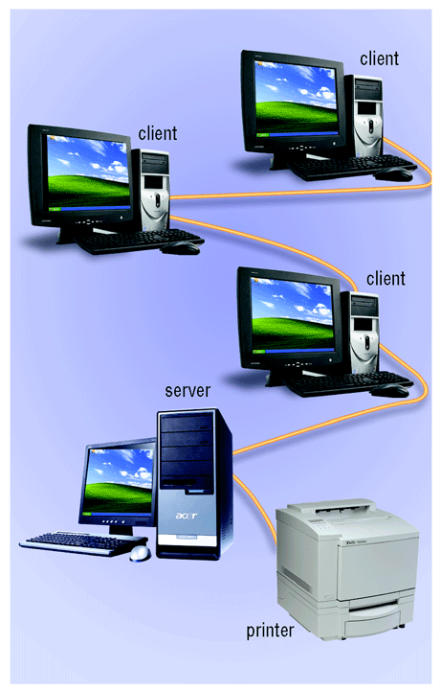
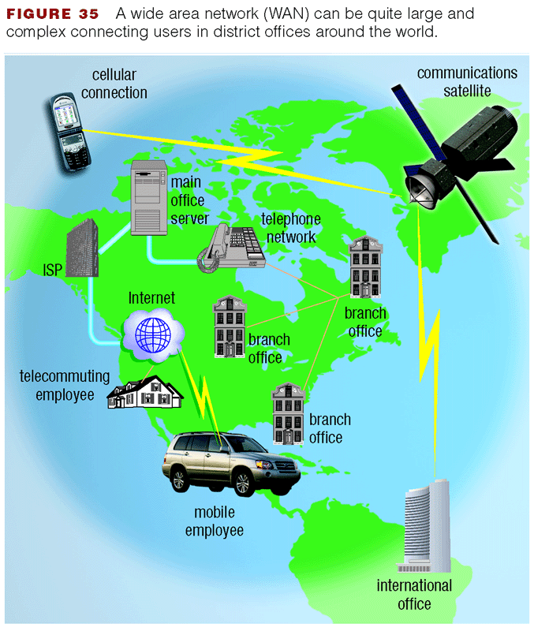
Networks and the Internet
Local Area Network (LAN)
Wide Area Network (WAN)

Slide 21
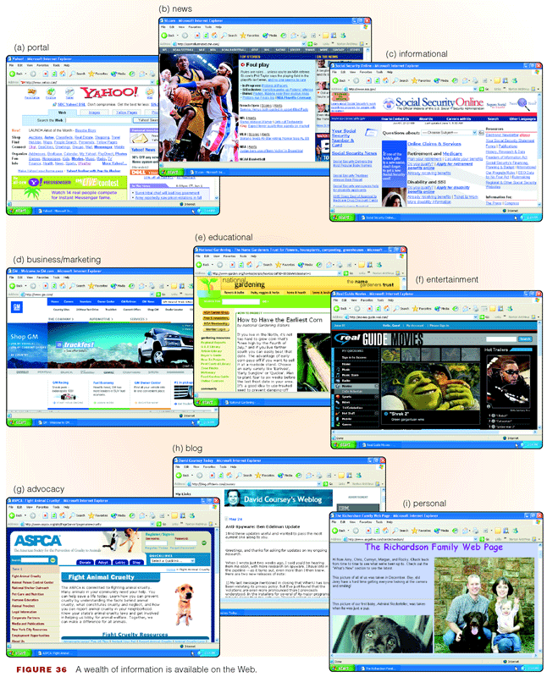
Networks and the Internet
The world’s largest network is the Internet
Most users connect to the Internet in one of two ways:
  Internet service provider
  Online service provider

Slide 22
The World Wide Web
One of the more popular segments of the Internet is the World Wide Web, also called the Web
A Web page is a document that contains text, graphics, sound, and/or video and has built-in connections, or hyperlinks to other Web documents
A Web site is a related collection of Web pages
You access and view Web pages using a software program called a Web browser
A Web page has a unique address, called a Uniform Resource Locator (URL)

Slide 23
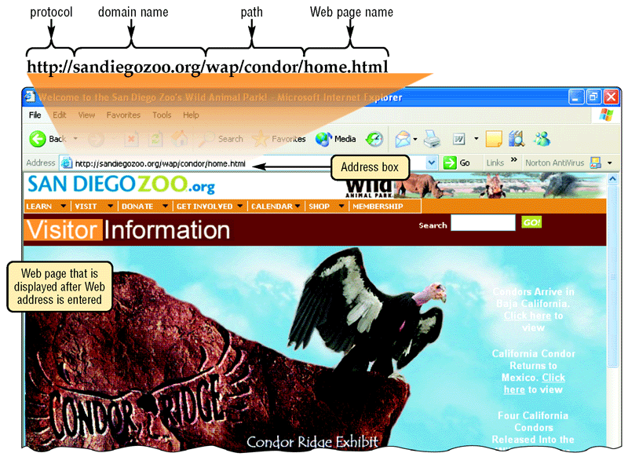
The World Wide Web

Slide 24
Electronic Commerce
When you conduct business activities online, you are participating in electronic commerce, also known as e-commerce
Business to consumer (B2C) involves the sale of goods to the general public
Consumer to consumer (C2C) involves one consumer selling directly to another
Business to business (B2B) provides goods and services to other businesses

Slide 25
Computer Ethics
Computer ethics are the moral guidelines that govern the use of computers and information systems.
Five areas:
  Unauthorized use of computer systems
  Software theft (piracy)
  Information privacy
  Information accuracy
  Codes of ethical conduct

Slide 26
Unauthorized Use of Computer
Unauthorized Access and Use
  Use of a computer or network without permission.
  Hacker : people who try to break into a computer with the intent of stealing or corrupting its data.
To prevent unauthorized use of computers : e.g. use of user identification and passwords.

Slide 27
Software Theft (piracy)
Software theft : e.g someone physically steal a DVD-ROM CD-ROM or floppy disk, or to intentional piracy of software.
Software piracy :
  unauthorized or illegal duplication of copy-righted software.
  When you purchase software, you actually do not own the software; instead, you have purchased the right to use the software, as outlined in the software license.
  A software license is an agreement that provides specific conditions for use of the software.

Slide 28
Information Privacy
Refers to the right of individuals and organizations to deny or restrict the collection and use of information about them.

Slide 29
Information Accuracy
Concerned about the accuracy of computer input.
Inaccurate input can result in erroneous information and incorrect decisions made.

Slide 30
Codes of Conduct
Written guidelines that help determine whether a specific computer action is ethical or unethical.
Examples:
  One may not copy or use software illegally.
  Computers may not be used to steal.
  Computers may not be used to harm other people.

Slide 31
Summary
Define the term computer and discuss the four basic computer operations: input, processing, output, and storage
Define data and information
Explain the principal components of the computer and their use
Describe the use of hard disks, USB flash drives, floppy disks, and other storage media
Discuss computer software and explain the difference between system software and application software

Slide 32
Summary
Identify several types of personal computer application software
Discuss computer communications channels and equipment and the Internet and World Wide Web
Define e-commerce
Discuss the ethical issues associated with software

